Slide 1

The information provided in this presentation (the “Materials”) is confidential and proprietary to Aganthos AI, Inc. and is provided for informational purposes only. These Materials contain forward-looking statements, estimates, and projections regarding Aganthos AI’s strategy, business model, and future performance. Actual results may vary materially from those projected due to market conditions, technology development, regulatory changes, and other factors. Aganthos AI assumes no obligation to update or revise these forward-looking statements. All intellectual property and content herein remain the sole property of Aganthos AI, Inc. Unauthorized use, distribution, or disclosure is strictly prohibited.
Organising the world’s human and artificial agents

Slide 2






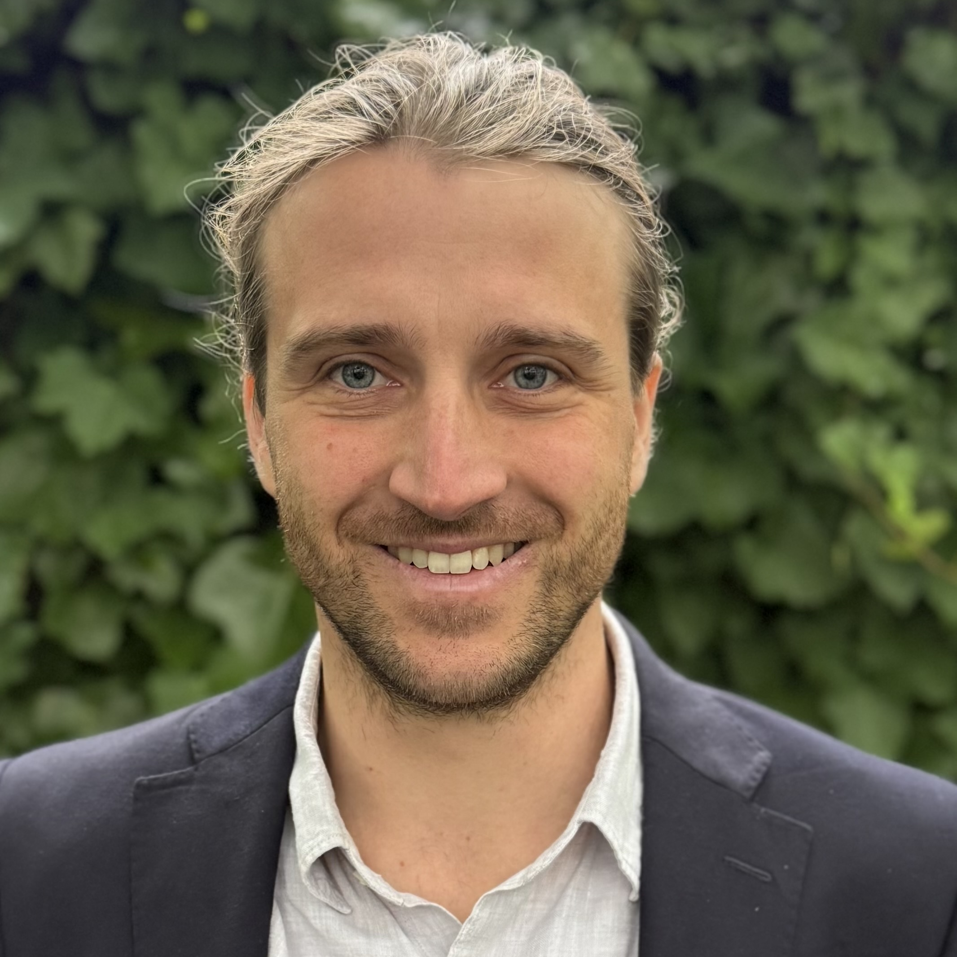





Orchestrate the Future Together
Founder: Pioneering AI from Research to Impact
A decade at the forefront of Reinforcement Learning (RL); AISTATS Best Paper nominee 2022
From theory to high-impact application: games, high-speed robotics, electron microscopes, web agents and tool calling
Founding Research Scientist at Convergence AI, leading the research team (Acquired by Salesforce in 2025)
TEAM
Founder
Design and implementation of a $2.6B national-scale crisis management team
Complex coordination and high-stakes decision-making across disciplines, sectors and levels
Generative AI in Public Health/Medicine/Climate
Founding technical staff
Experienced SWE building data platforms on AWS and GCP across BMW Group and BMW
Cloud deployment of custom RAG agents at BMW

Slide 3
Status
Q4 2025
Scientific validation: Neurips workshop paper
DE C-Corp incorporation
1st paid partnership secured
R&D with a first customer and international researchers
Trained proprietary 1.5B/3B parameter models for tool orchestration
Early discussions and building relationships for design partnerships with multinational companies
Q1 2026
Two ICML submissions
Swiss headquarter: Incorporation of Swiss GmbH
First revenue-based projects finished
RL Post-Trained Medical Model with German University Hospital (+30% improvement over o4-mini on clinical benchmarks)
Traction

Slide 4
we enable agents
to learn from experience​

Slide 5
AI Agent Challenges
“AI hits a wall” before becoming productive
Unreliable & insufficient performance
Handling sensitive data
Rising model costs
Notes:
Unreliable & insufficient performance: manual correction and constant oversight
Privacy barriers: Sensitive data can’t leave the organisation
Rising model costs: model spend grows with usage
We addreass each one of them

Slide 6

We create measurable value
Improve Performance
Reduce Cost
Enable Privacy
Reinforcement Learning (environments) / In-Context-Learning (usage traces)
Routing + small models
Knowledge transfer + local deployment
• Higher success rate
• Fewer human escalations
• Better decision quality
asd
• Lower cost per request
• Lower latency
• Scalable usage
• Data never leaves your organisation
• Vendor independence
• Regulatory compliance

Slide 7
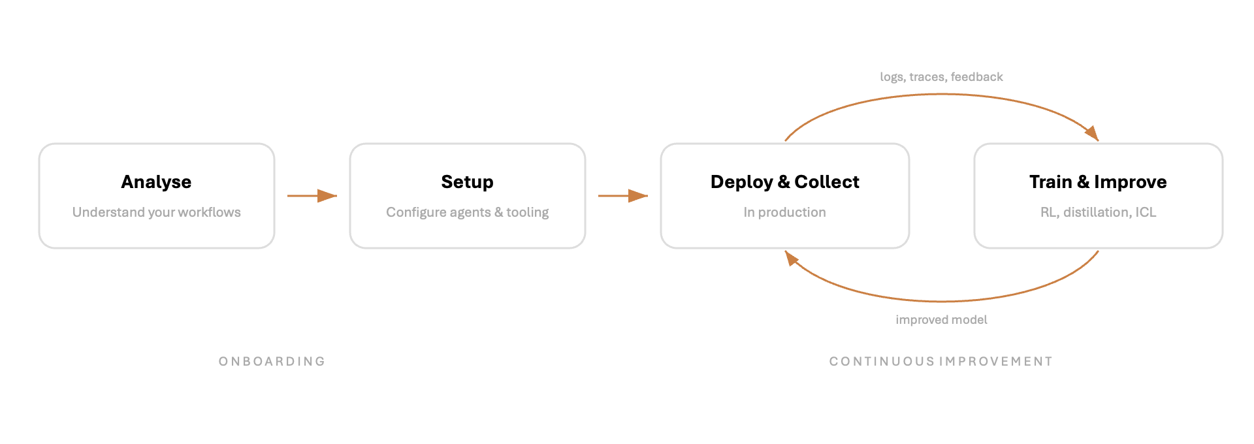
The Learning Flywheel Learning as a Service

Slide 8
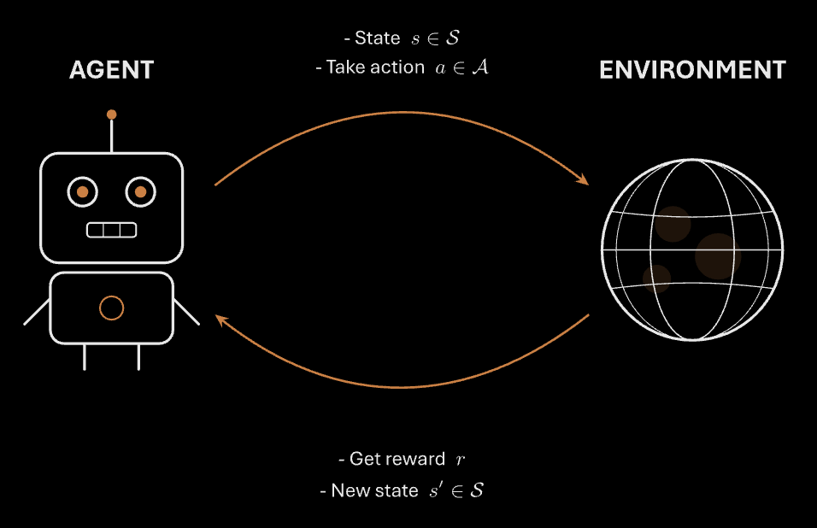
Learning Agents

Slide 9
A Case Study with a large German University Hospital (Post-training as Service)
Important milestone towards a universal optimization engine for AI agents:
Successful demonstration with generalisability to any complex demanding setting
Performance drives ROI: Potential to save 5-15 full time equivalents in medium to large sized hospitals (>1 Mio Euro)* with +30% improvement over o4-mini (generalised Frontier Model) on clinical benchmarks ​
Cost: Substantial reduction in inference costs
Sovereignty: Working in high-privacy setting
Detailed results not publicly shareable yet. We are happy to share them on a 1:1 basis
*under conservative assumptions

Slide 10
From Pilot to Long-lasting Customer Relationship
Identify
Identify processes for agentic augmentation
(KPI and stakeholder)
Evaluate
CUSTOMER JOURNEY
Test and select the most effective AI models for your organisation (build evaluation set + evaluation standard models)
Optimise
Enhance AI performance with customised training and adjustments (optimise by In-context learning, fine-tuning or context engineering)
Maintain
Launch your AI agent and keep it improving with your feedback
Monetisation through hourly setup fees and usage tiers/ maintenance fees

Slide 11
From Paid Pilots to scalable ARR
Agent and orchestration learning layer monetisation
Hourly setup fees
Maintenance fees and continuous improvement fees
Usage based tiers of trained model
Aganthos Joint Ventures (planned starting in Q2 2026)
Equity + selling goods & services
Revenue share
MONETISATION

Slide 12

Competition Landscape
LEARNING AUTOMATION
PLATFORM
scalable solutions
learning &
orchestration layer
Aganthos
Orby AI, Adept AI, Imbue,
STATIC PLATFORMS
N8N
Zapier
Sema4.ai
11x.ai
Lindy AI
learning & training infrastructure
Tinker/Thinking Machines Lab, Serverless RL/CoreWeave
Players in the field
no learning from experience /
static automation
learning from experience​ (reinforcement learning)
LEGACY BPO (with LLM-Wrapper)
Accenture
Deloitte
UiPath
BESPOKE
INTELLIGENCE
Palantir
InstaDeep
Applied Intuition
Helm.ai
PolyAI
services

Slide 13

Proven technical foundation, now ready to scale with partners
..24 |  | 25 |  |  |  | 26 |  |  |  | 27
… | Q4 | Q1 | Q2 | Q3 | Q4 | Q1 | Q2 | Q3 | Q4 | Q1 | Q2 | Q3
RL Research & Benchmark Validation
 |  | RL Posttraining |  |  | Multi-Step |  | + HITL |  | …continuous improvement
 |  |  |  |  | First hire | Researchers & Engineers
 |  |  |  | 1st paid Partnership |  | 2-3 Design Partnerships |  | Joint Venture
Scaling
Pre-seed
Series A
Traction to Date:
Trained proprietary 1.5B and 3B parameter models for tool orchestration. Functional UI prototype developed and in iteration.
Initial co-entrepreneur explorations underway with firms in Law, Finance, and Lobbying, and Coaching/Mediation.
Demo interface built.
Currently:
In discussion with multinational companies for design partnerships.
Next (With Pre-Seed Funding):
Q3/Q4 2025: Complete onboarding of our first 3 Design Partners and train the model.
2026 Ship V1 of the Nexis Orchestration Platform and full Personal Project Manager UI. Launch joint ventures.
2027: Scale development to enable "Multi-Step + Multi-Human" orchestration.
Notes:
Ggf. Auf zwei Folien

Slide 14
We empower professionals to break free from routine tasks.
We orchestrate a world where human creativity thrives.
We innovate to build breakthrough solutions for a better future.
We provide the learning layer for agents that drive performance.
www.aganthos.com
info@aganthos.com

